Slide 1
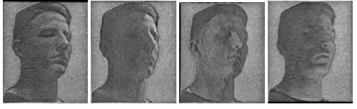
SHADOWPIX: Multiple Images from Self Shadowing
Amit Bermano Ilya Baran Marc Alexa Wojciech Matusk
Disney Research Zürich ETH Zürich TU Berlin MIT CSAIL Disney Research Boston

Slide 2
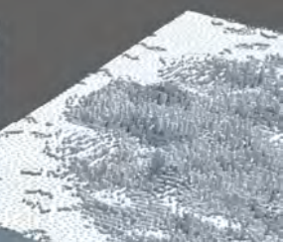
Global Method
The shadowPix is a simple heightfield where each element (pixel) is of the same size
Each element can both cast and receive shadows
Each element is either completely shadowed or not (no grayscale)
Solved as an optimization problem

Slide 3
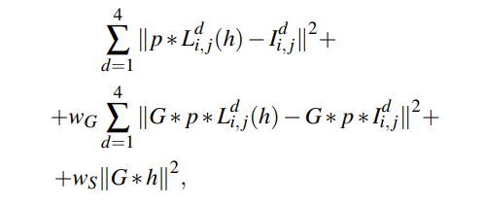
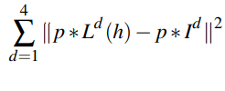
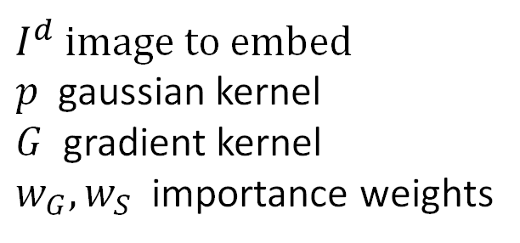
Function to minimize
$I^{d}$ image to embed
$p$ gaussian kernel
$G$ gradient kernel
$w_{G}, w_{S}$ importance weights
Similarity term
Edge preserving term
Smoothening term

Slide 4
Implementation
Implemented in Python for up to 4 images
Heightfield to printable stl
Optimization algorithm
State score function
Concurrency optimization
Global interpreter lock -> no time saving
Processes instead of threads - Multiprocessing
Lots of data copied between process -> no time saving
Linux has copy on write -> 2X faster

Slide 5
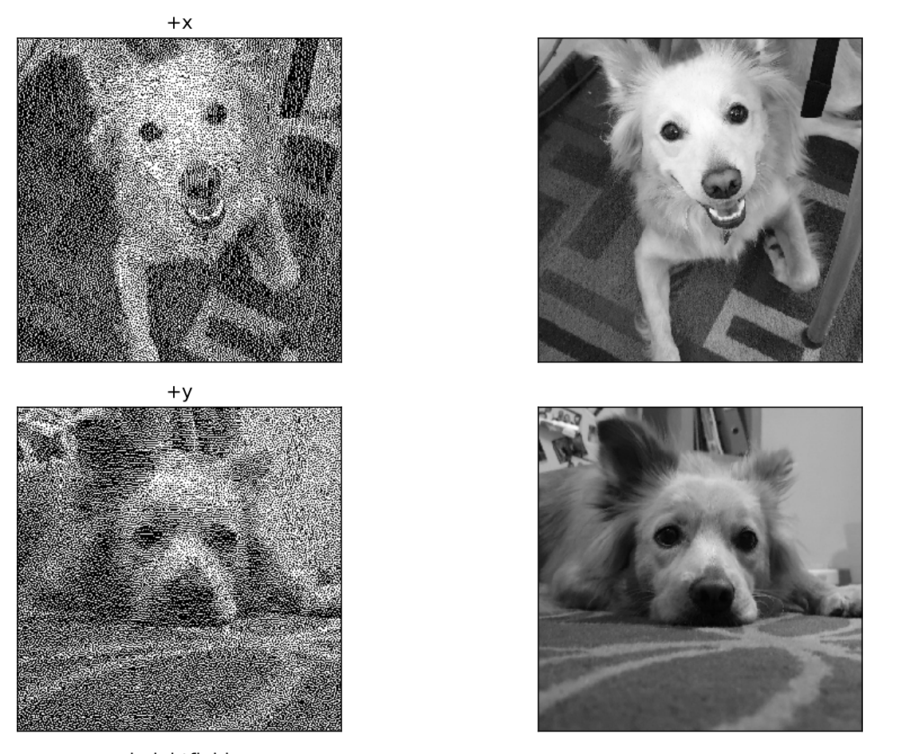
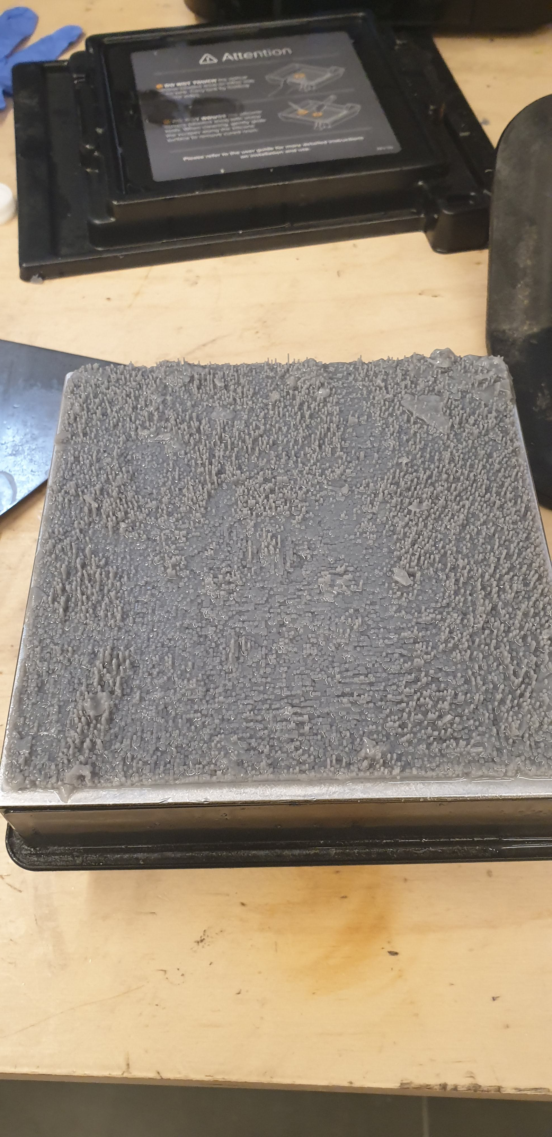
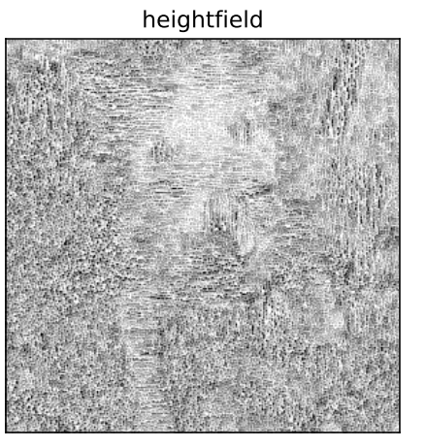
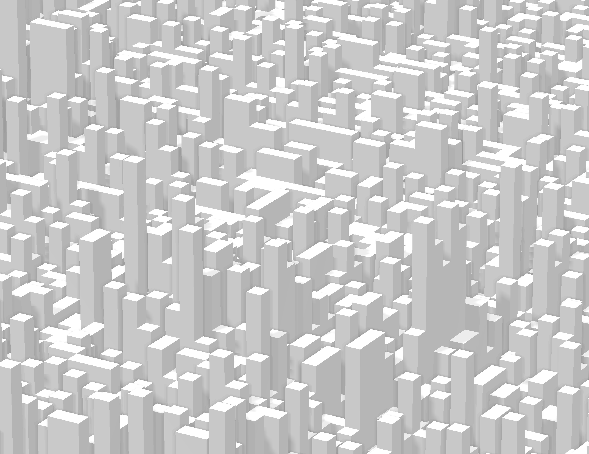
Assi – 2 images

Slide 6
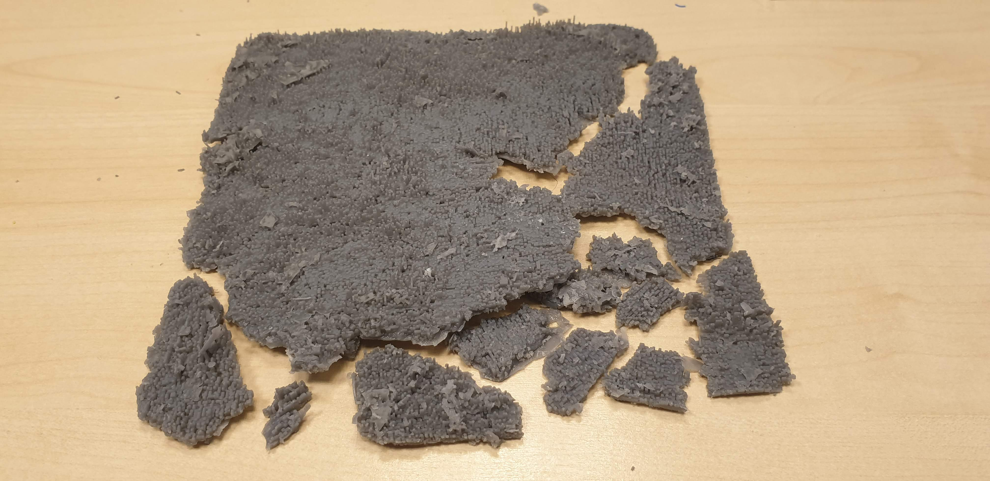
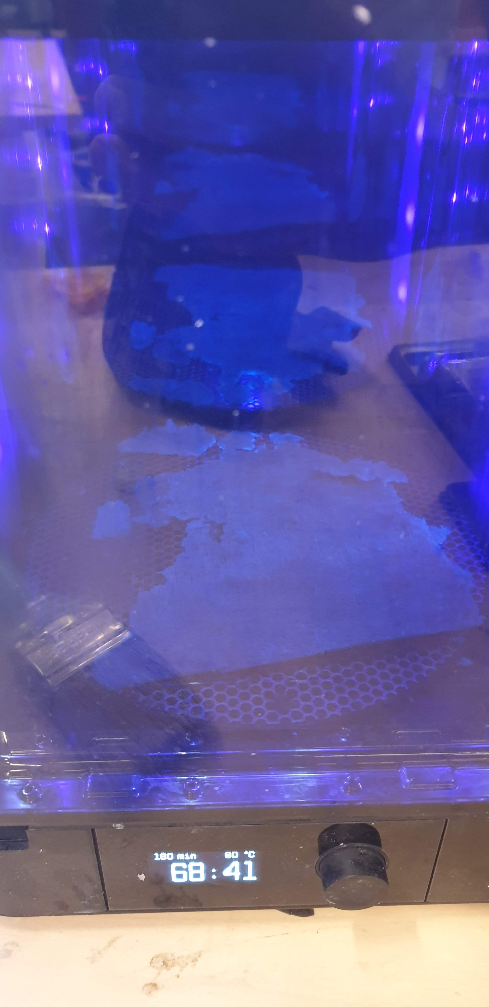

Slide 7
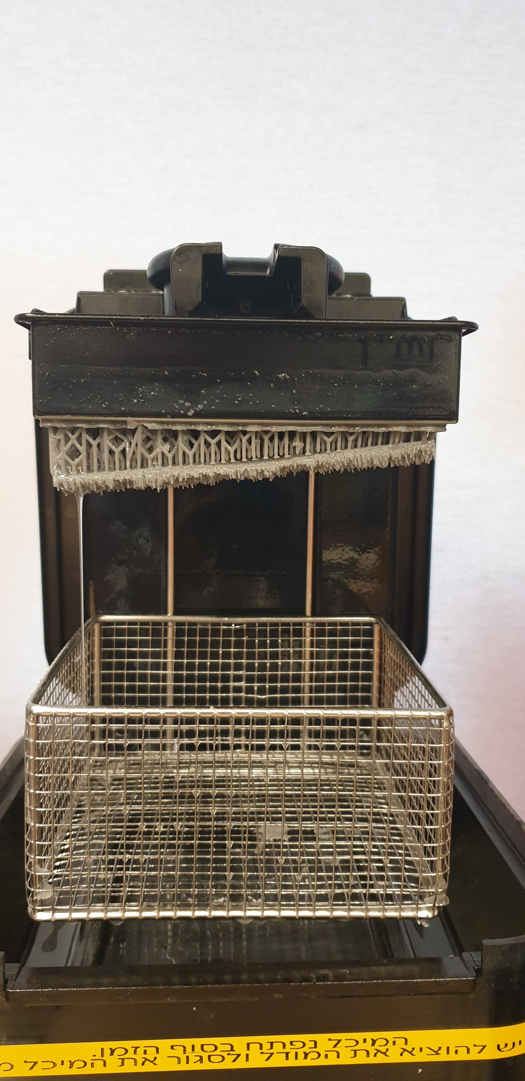
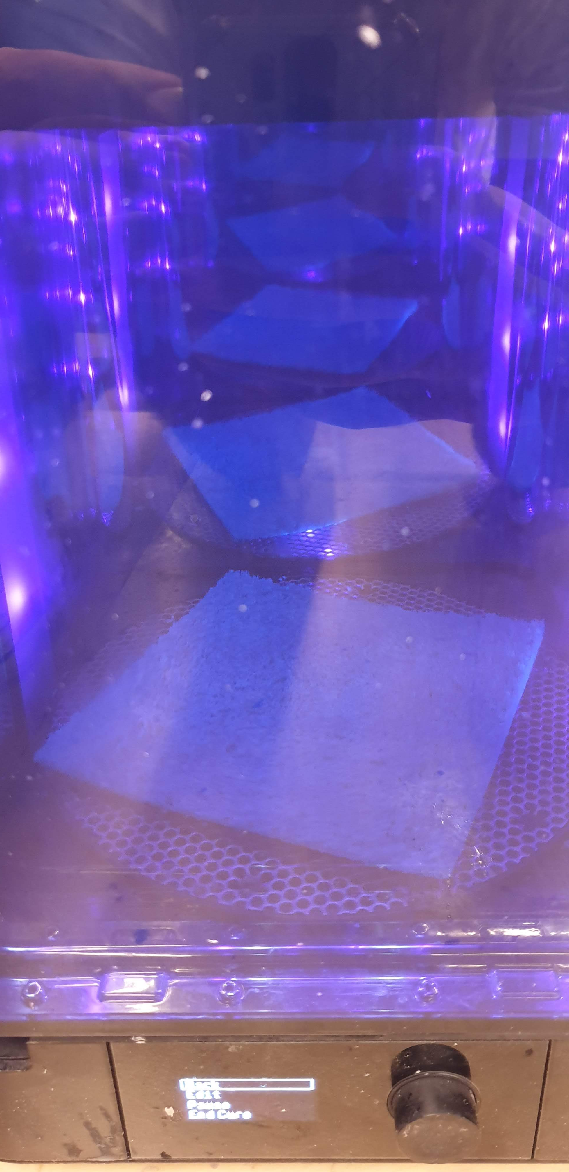
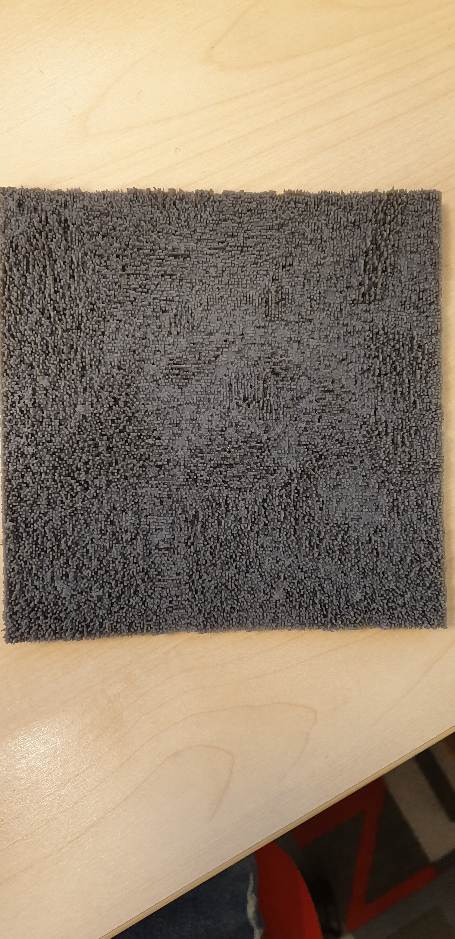
Second attempt

Slide 8
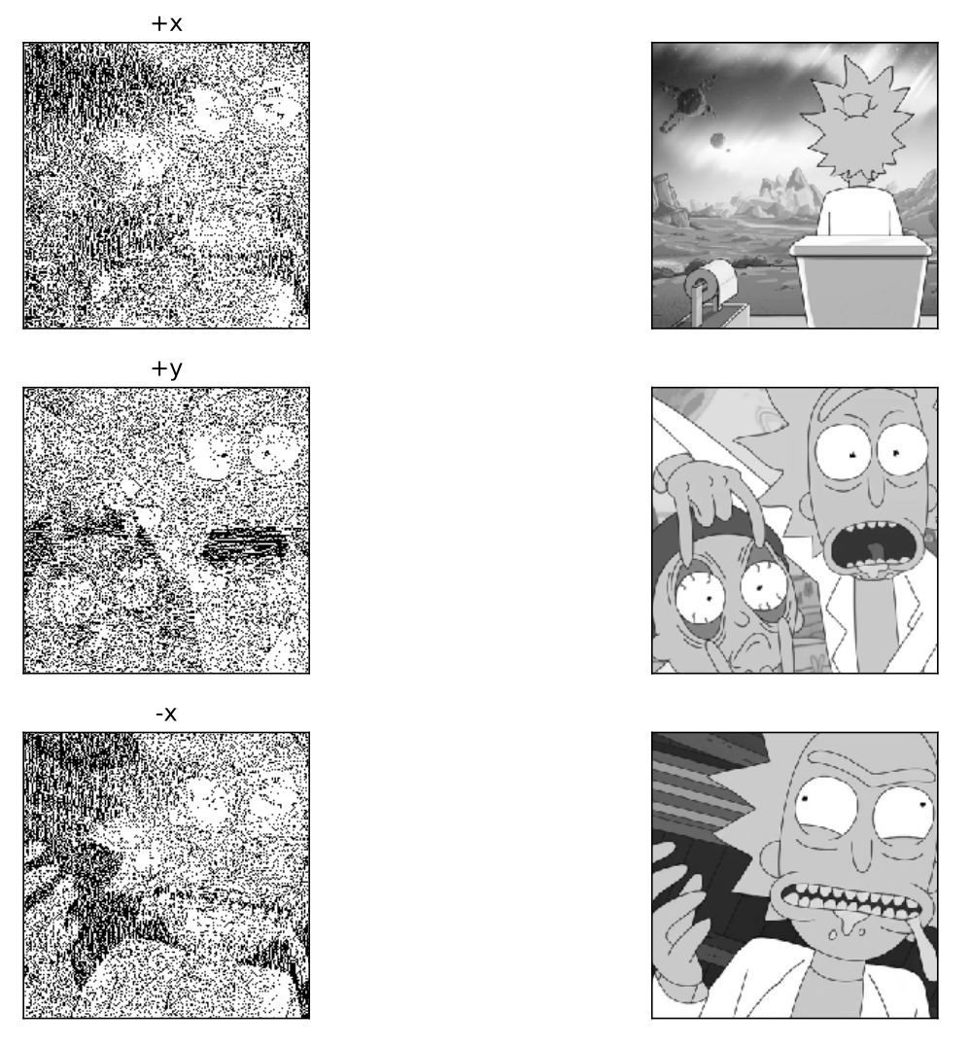
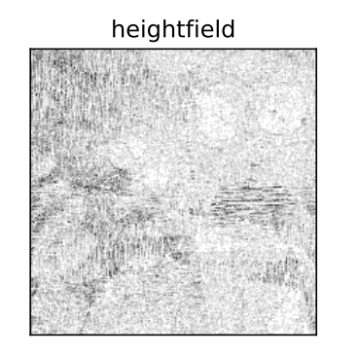
Rick and Morty

Slide 9
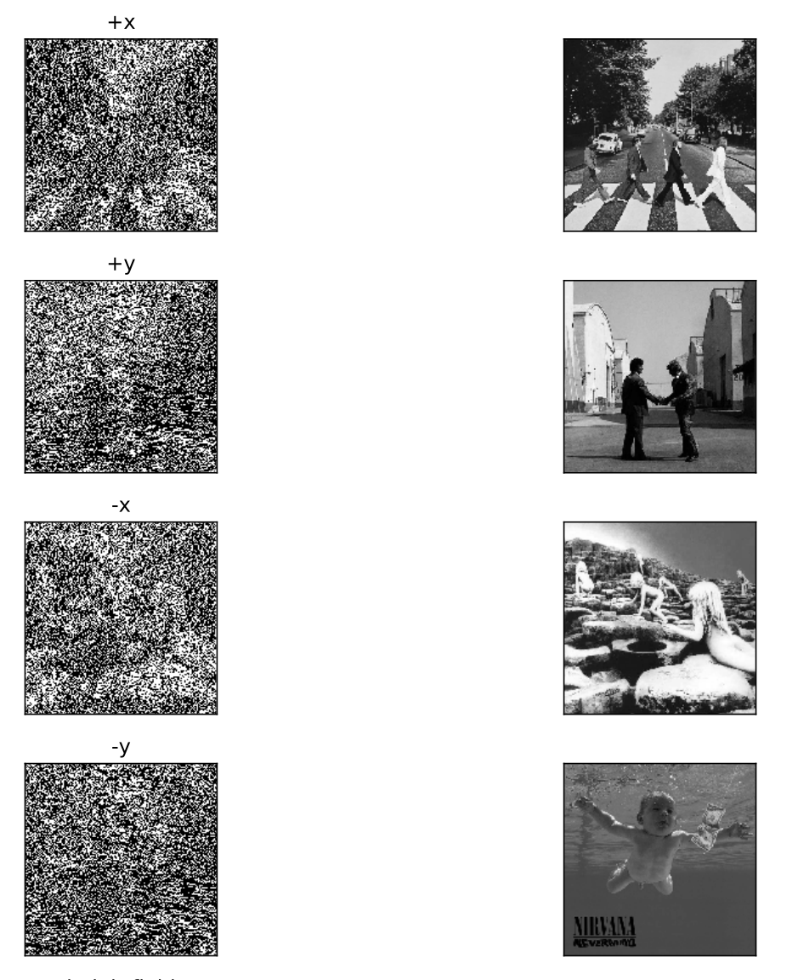
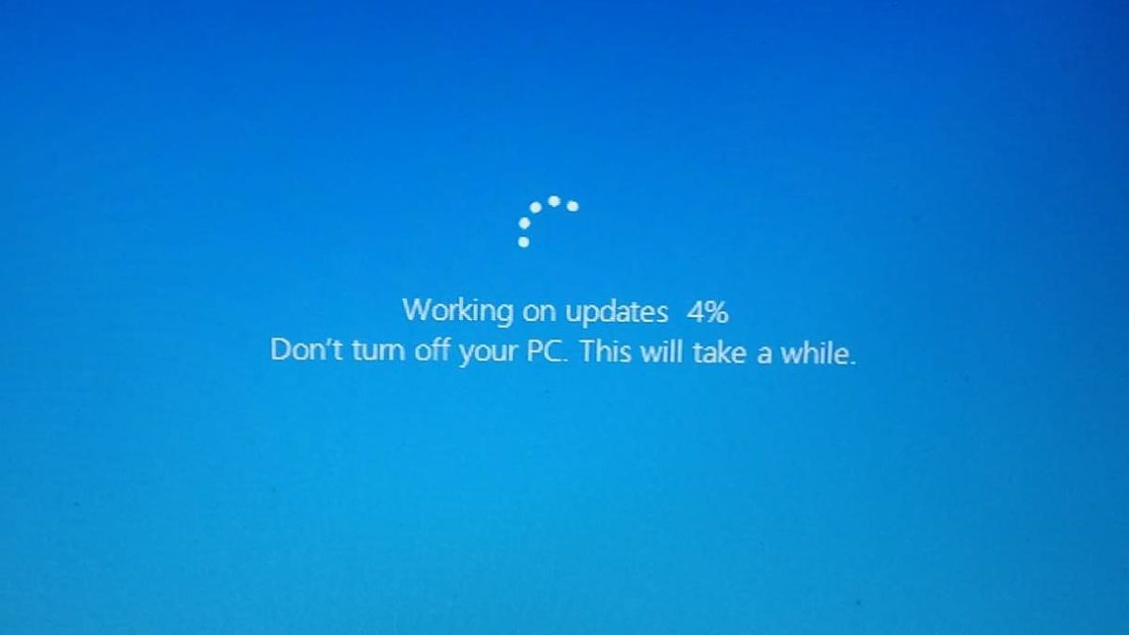
Albums - 4 images
Intermediate res after 24h

Slide 10
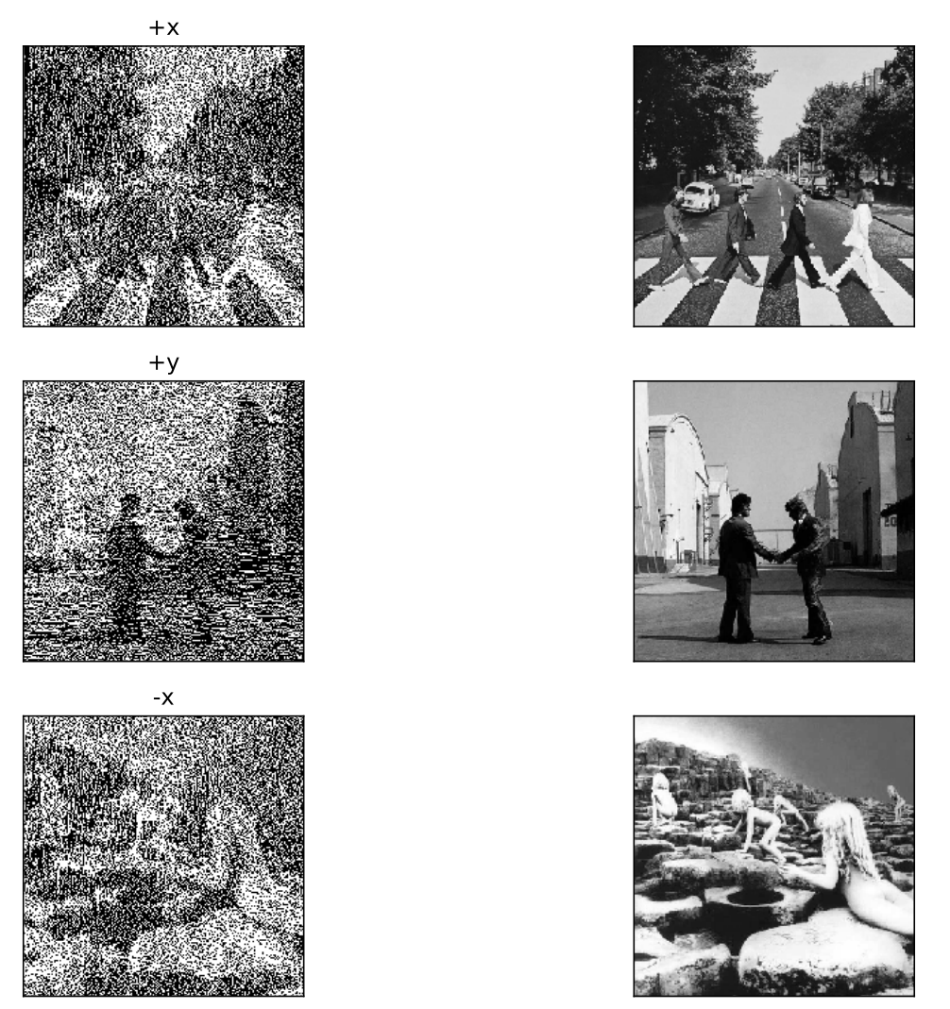
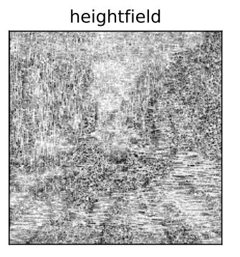
Albums – 3 images

Slide 11
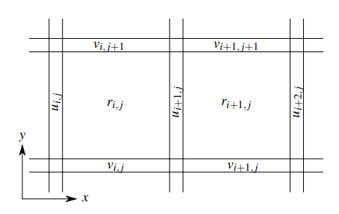
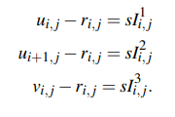
Local Method
Θ
H=sI¹_{ij}
Un-shadowed fraction
u_{ij}
H / s = I¹_{ij}
r_{ij}
r_{i,j} < min(u_{i,j} ,u_{i+1,j} , v_{i,j} , v_{i,j+1})
Make sure that only the walls are casting shadows
s.t
for –x and +x: |u_{i,j} − u_{i+1,j}| < s
Shadows are contained only in the pixels adjacent to the walls
for +y direction: v_{i,j} − v_{i,j+1} < s

Slide 12
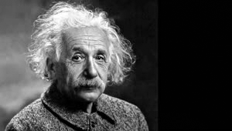
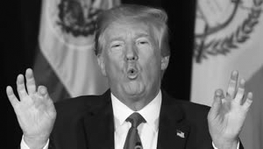
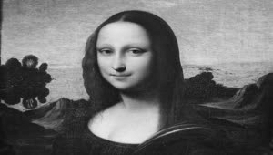
Implementation
Python
Reconstruction using the illuminated area:
Simulation using Unity3D

Slide 13
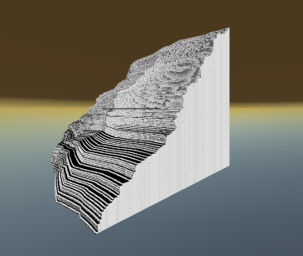
Simulation

Slide 14
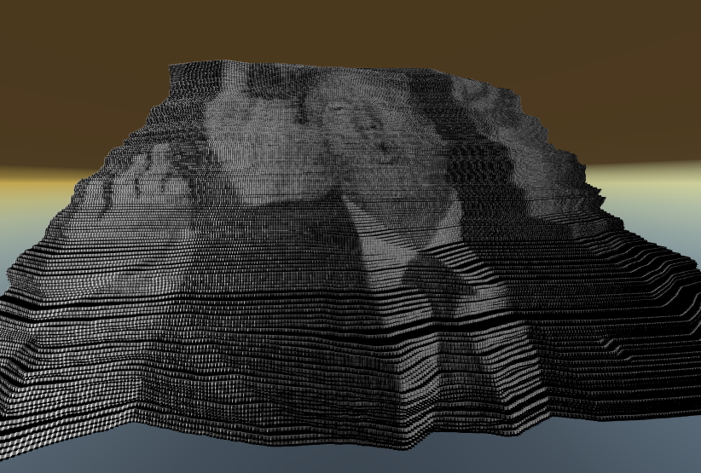
Simulation

Slide 15
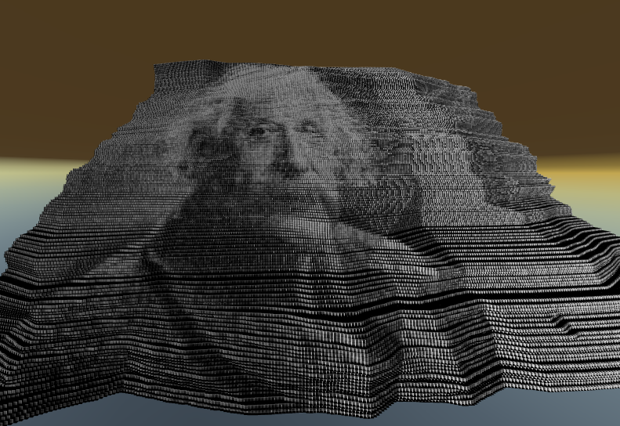
Simulation

Slide 16
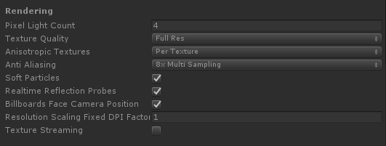
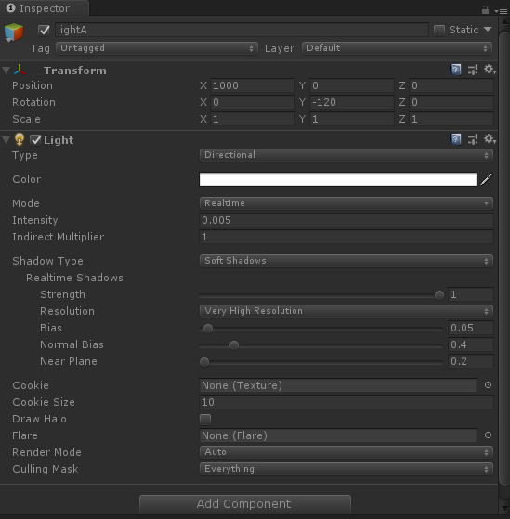
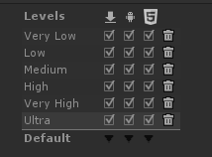
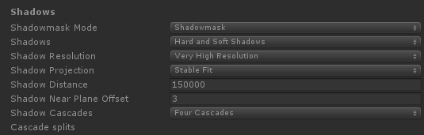
Simulation
Notes:
The Hard Shadows setting produces shadows with a sharp edge. Hard shadows are not particularly realistic compared to Soft Shadows but they involve less processing, and are acceptable for many purposes. Soft shadows also tend to reduce the “blocky” aliasing effect from the shadow map.
The Anti-aliasing effect gives graphics a smoother appearance. Aliasing is an effect where lines appear jagged or have a “staircase” appearance (as displayed in the left-hand image below). This can happen if the graphics output device does not have a high enough resolution to display a straight line.
The more cascades you use, the less your shadows will be affected by perspective aliasing

